Slide 1
Scripting Languages -deepankar sharma

Slide 2










Slide 3
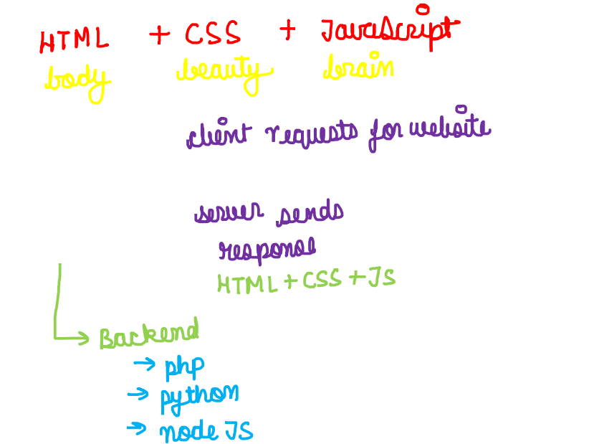

Slide 4
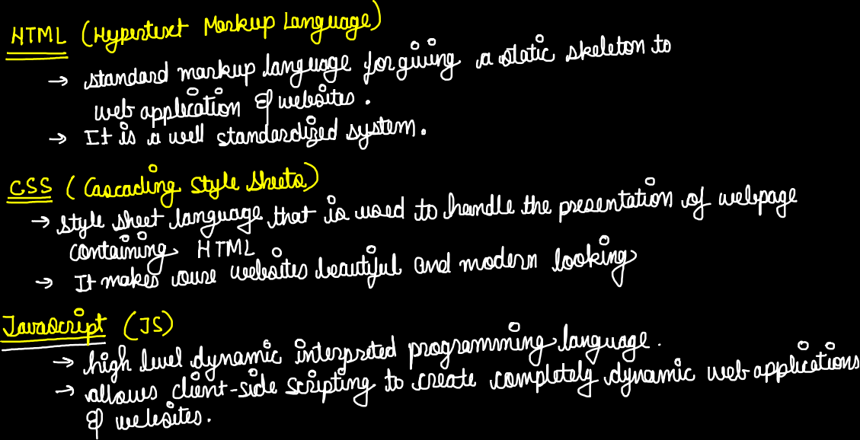

Slide 5










<!DOCTYPE html>
<html lang="en">
<!-- head contains all the metatags -->
<head>
<meta charset="UTF-8">
<meta http-equiv="X-UA-Compatible" content="IE=edge">
<meta name="viewport" content="width=device-width, initial-scale=1.0">
<title>Lucky</title>
</head>
<!-- body contains the content of the web page -->
<body>
Hello Lucky
</body>
</html>

Slide 6








<!-- head contains all the metatags -->
<head>
<meta charset="UTF-8">
<meta http-equiv="X-UA-Compatible" content="IE=edge">
<meta name="viewport" content="width=device-width, initial-scale=1.0">
<meta name="description" content="This is description">
<meta name="keywords" content="html, python, web development">
<!-- <meta name="robots" content="NOINDEX, NOFOLLOW"> -->
<meta name="robots" content="INDEX, FOLLOW">
<!-- This is how we include external css -->
<link rel="stylesheet" href="temp.css">
<!-- This is how we include external js -->
<script src="temp.js"></script>
<title>Lucky</title>
</head>

Slide 7
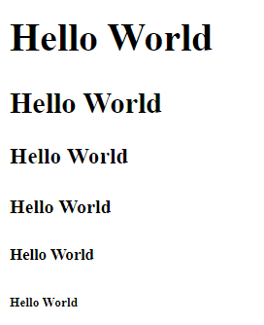














<h1>Hello World</h1>
<h2>Hello World</h2>
<h3>Hello World</h3>
<h4>Hello World</h4>
<h5>Hello World</h5>
<h6>Hello World</h6>
<p>This is a paragraph</p>

Slide 8
















<strong>This is strong.</strong>
<em>This is emphasized.</em>
<!-- not recommended after HTML5 -->
<b>This is bold.</b>
<i>This is italic.</i>

Slide 9





























<a href="https://google.com">Go to google</a>
<a href="https://facebook.com">Go to facebook</a>
<a href="https://twitter.com">Go to twitter</a>
<a href="https://amazon.com">Go to amazon</a>
<a href="https://amazon.com" target="_blank">Go to amazon</a>
<a href="tut4.html">tut4</a>
<img src="pp.jpg" alt="Error Loading Image">

